Slide 1

INCOME PREDICTION USING MACHINE LEARNING TECHNIQUES
IE 7374 – MACHINE LEARNING IN ENGINEERING

Slide 2
TEAM MEMBERS
SOHAM BHOGALE
REHUL GHAG
SIDDHANT DUBE

Slide 3
PROJECT OVERVIEW
Perform
Perform data pre-processing on the dataset to best fit the machine learning models
Perform
Perform Exploratory Data Analysis (EDA) on the dataset to visualize the data
Fit
Fit the dataset into the machine learning models
Make alterations to the dataset to compare the performance of the models

Slide 4
ABOUT OUR DATA
The dataset we collected was from the University of California Irvine machine learning repository. Our dataset was titled as the Adult income dataset which was extracted by Barry Becker from the 1994 census database.
The dataset consists of 14 records which are categorized as the input parameters, and 1 output which is initially in the format of “>$50k” or “<=$50k”.
  Our main objective is to predict if an individual's income exceeds the amount of 50,000 USD or not.
The dataset consists of 32,559 instances.

Slide 5
HOW THE ORIGINAL DATA LOOKS LIKE
 | age | workclass | fnlwgt | education | education_num | marital_status | occupation | relationship | race | sex | capital_gain | capital_loss | hours_per_week | native_country | income
0 | 50 | Self-emp-not-inc | 83311 | Bachelors | 13 | Married-civ-spouse | Exec-managerial | Husband | White | Male | 0 | 0 | 13 | United-States | <=50K
1 | 38 | Private | 215646 | HS-grad | 9 | Divorced | Handlers-cleaners | Not-in-family | White | Male | 0 | 0 | 40 | United-States | <=50K
2 | 53 | Private | 234721 | 11th | 7 | Married-civ-spouse | Handlers-cleaners | Husband | Black | Male | 0 | 0 | 40 | United-States | <=50K
3 | 28 | Private | 338409 | Bachelors | 13 | Married-civ-spouse | Prof-specialty | Wife | Black | Female | 0 | 0 | 40 | Cuba | <=50K
4 | 37 | Private | 284582 | Masters | 14 | Married-civ-spouse | Exec-managerial | Wife | White | Female | 0 | 0 | 40 | United-States | <=50K

Slide 6

Exploratory DATA ANALYSIS

Slide 7
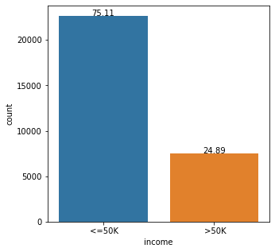
EDA
Given that the class imbalance is not severe and that both class labels are equally important, it is common to use classification accuracy or classification error to report model performance on this dataset.

Slide 8
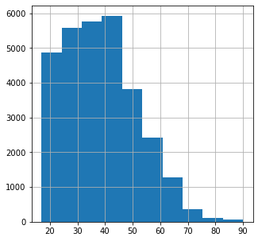
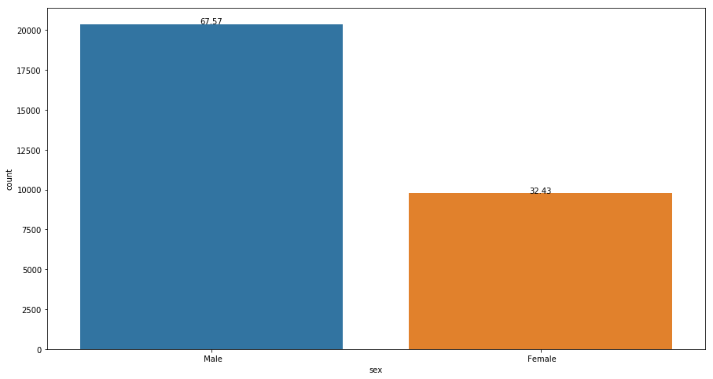
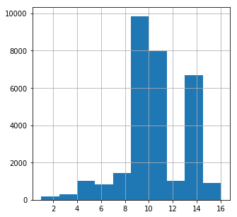
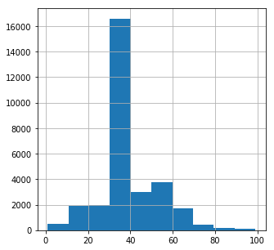
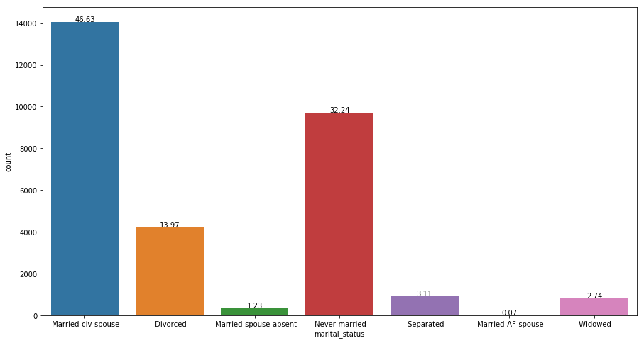
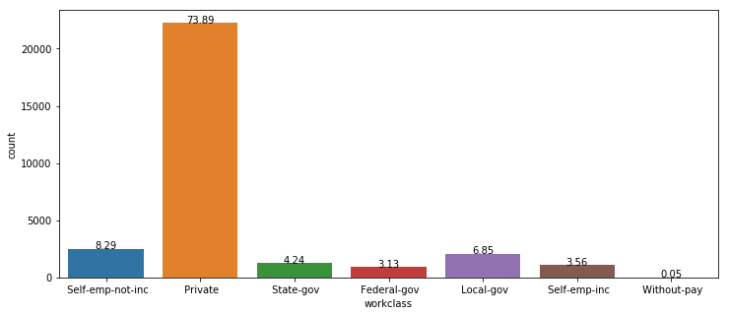
EDA
Age
Sex
Education Number
Hours per week
Work class
Marital Status

Slide 9
METHODOLOGY

Slide 10
DATA PRE-PROCESSING
Missing values were present in the dataset as a question mark (?). The missing values were located and replaced with a nan value.
  All rows with a nan value were eliminated from the table.
Non numerical columns were encoded to hold numerical values.
  Output was converted from a “<=$50k” or “>$50k” to a 0 and 1 datatype.
We used 10,000 random instances of our dataset due to hardware limitations.
The data was scaled using a standard scaler.
  Variables were independent
  Data was normalized to stand between a particular range

Slide 11
DATA PRE-PROCESSING
Some features from the original dataset were dropped from the dataset.
  FNLWGT
    Does not hold much significance to the dataset
  Relationship
    Determined by marital status and sex
  Education
    Determined by education_num
Feature dependency reduced

Slide 12
How the cleaned data looks like
 | age | workclass | education_num | marital | occupation | race | sex | capital gain | capital loss | hours per week | country | income
26145 | -0.566279 | -0.208884 | -0.439703 | 0.947877 | 0.754439 | 0.385055 | 0.692823 | -0.147437 | -0.21859 | 0.172682 | 0.264929 | 0
28094 | -0.414010 | -0.208884 | -0.439703 | -1.722362 | 1.250788 | 0.385055 | -1.443370 | -0.147437 | -0.21859 | -0.077735 | 0.264929 | 0
22580 | 0.575737 | 1.888018 | -0.439703 | -0.387243 | 1.747138 | 0.385055 | 0.692823 | -0.147437 | -0.21859 | 0.756990 | 0.264929 | 0
7971 | -0.566279 | -0.208884 | 1.128961 | 0.947877 | 0.754439 | 0.385055 | -1.443370 | -0.147437 | -0.21859 | -0.077735 | 0.264929 | 0
9267 | -0.337876 | -1.257334 | -0.047537 | -0.387243 | -0.734609 | 0.385055 | 0.692823 | -0.147437 | -0.21859 | -0.077735 | 0.264929 | 1

Slide 13
MACHINE LEARNING MODELS
Logistic Regression
Base model for our project
Support Vector Machine
Neural Network

Slide 14
LOGISTIC REGRESSION
Data split into a testing and training set with a ratio of 20:80 respectively.
Implemented using the Logistic Regression class.
A good fit because of our dataset output being a binary data type. Excellent for binary classification problems

Slide 15
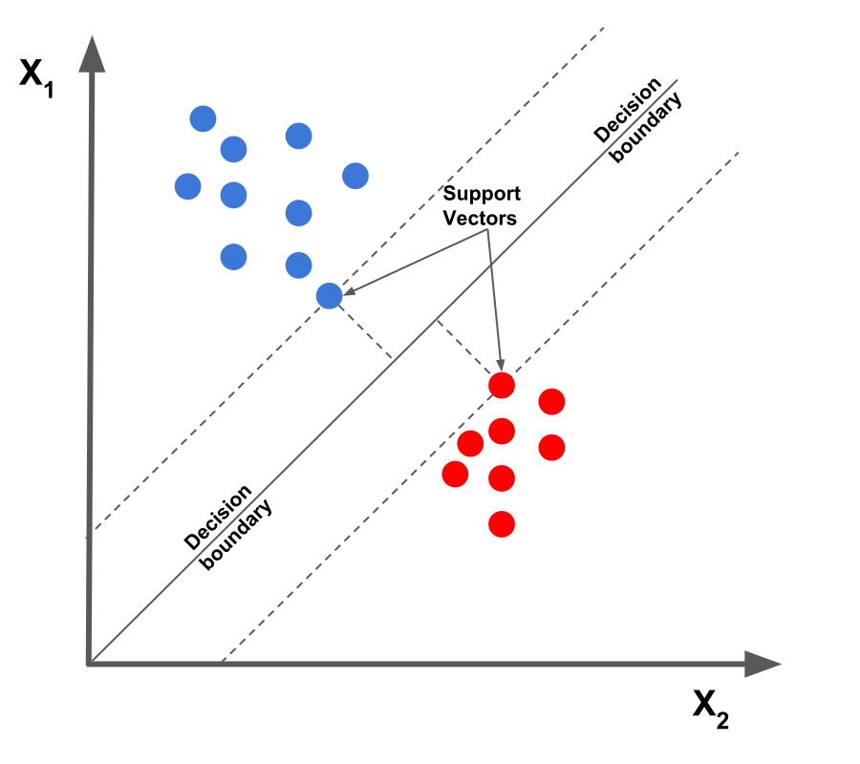
Support Vector machine
Good model to solve classification problems.
Implemented using the SVM class.
Dataset converted into a NumPy array for better fitting.

Slide 16
Neural network
Ideal for clustering and classification problems.
Sigmoid function used to best fit the binary output.
_______________________________________________________ Layer (type) Output Shape Param # ========================================== dense (Dense) (None, 128) 1536 _______________________________________________________ dense_1 (Dense) (None, 256) 33024 _______________________________________________________ dense_2 (Dense) (None, 256) 65792 _______________________________________________________ dense_3 (Dense) (None, 256) 65792 _______________________________________________________ dense_4 (Dense) (None, 1) 257 ========================================== Total params: 166,401 Trainable params: 166,401 Non-trainable params: 0 _______________________________________________________

Slide 17
RESULTS

Slide 18
LOGISTIC REGRESSION
For the logistic regression model, we passed in three variations of our dataset to compare what factors affect the performance of the model. The bias-variance tradeoff exists in this model.
Technique 1
Using 1000 random instances and using 10,000 random instances
1000 instances gave an accuracy of 68%
10,000 instances gave an accuracy of 67.1%
Technique 2
Using the dataset after cleaning and eliminating necessary features
Accuracy was 70%
Precision was 45.8%
Recall was 95.4%
Technique 3
Using the dataset with only the numerical columns from the original dataset
Accuracy was 74.9%
Precision was 49.8%
Recall was 95.6%

Slide 19
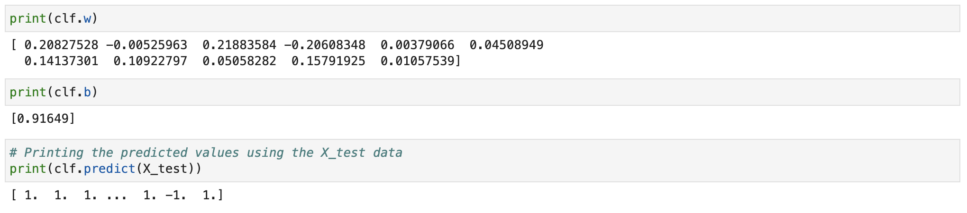
Support vector machine
The performance metric was the output returned by the predict function.

Slide 20
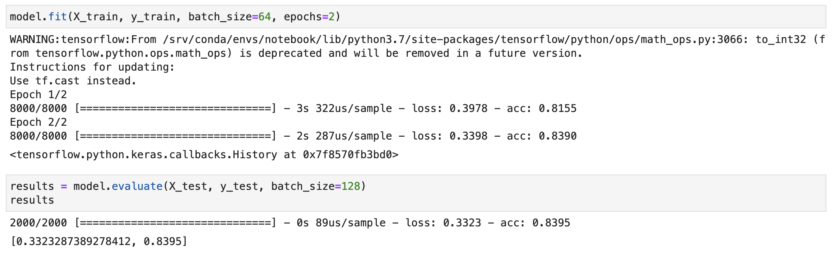
Neural network
5 layers were built on the sequential neural network model
Sigmoid function was used to handle the binary output
The metric was set as the accuracy of the model

Slide 21
Q&A

Slide 22
THANK YOU

